Slide 1
DATA STRUCTURES AND ITS APPLICATIONS (UE22CS252A)
Mini Project

Slide 2
Project Title & Team Members
Title: Supermarket Management System
Team Members (SRN Name)
Keerthana Kalidindi(PES2UG22CS262)
Khushi P(PES2UG22CS264)
Mahika Datta (PES2UG22CS292)
Maitri Shekhda(PES2UG22CS294)

Slide 3
Project Description
Synopsis:
Our project is based on supermarket management system. It has 2 subdivisions i.e., admin and user login.
If the choice entered is admin login, then the admin has an option to view the products or update them as necessary.
If the choice entered is user login, then the user can view the products, add items to the cart, delete items from the cart or search for a product
User login
Admin login

Slide 4
Project Title & Team Members
ADT used:
Singly linked list
Insert items
Delete items
Order items according to expiry date
Update details of items
Multi linked list
- consists of the subcategories which links to the singly linked list containing all the items individually

Slide 5
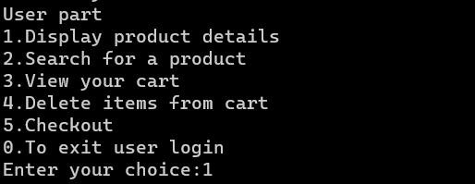

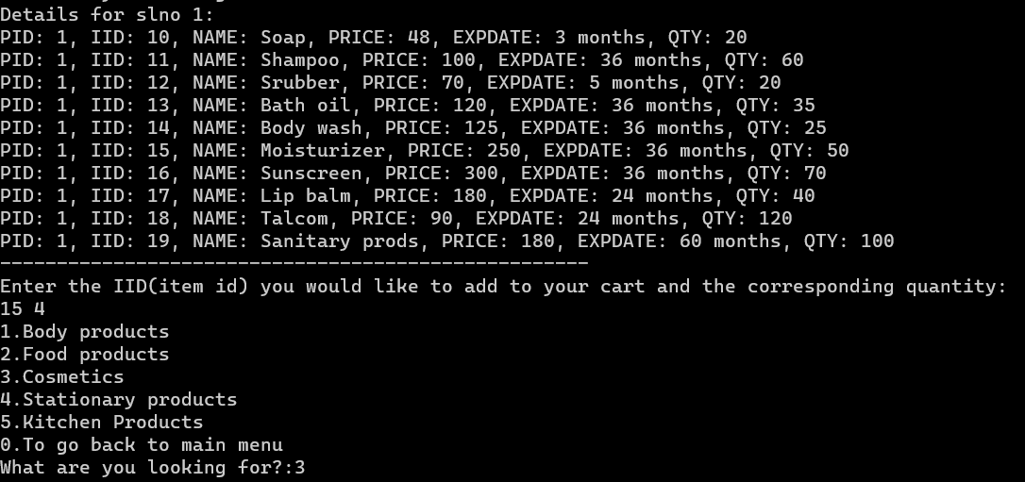
Project Title & Team Members
For choice 1(user login)
For displaying all items(choice 1)

Slide 6

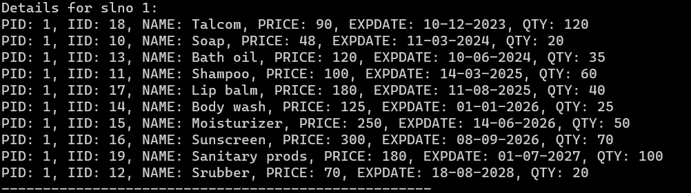
Project Title & Team Members
To search for an item
To view items in cart
To order items according to expiry date

Slide 7
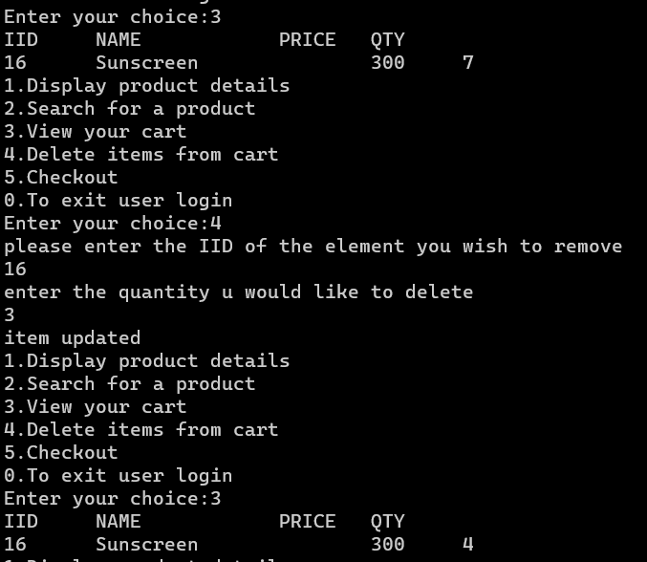
Project Title & Team Members
To delete items from cart

Slide 8
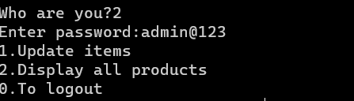
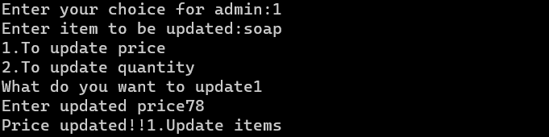
Project Title & Team Members
Admin login(choice 2)
To update details of items

Slide 9
Contribution of each Team Member
This should be last slide mentioning contribution of each member
Keerthana – Ordering the items according to expiry date and user login
Khushi – Delete item(for admin) and sell item(for user)
Mahika – Search for an item, admin login and update details of item
Maitri – Insert items into the multi linked list

